Slide 1
G.Swapna
Lecturer in Botany
SRR & CVR GDC
Vijayawada

Slide 2
PUCCINIA
CLASSIFICATION:
Kingdom: Mycota
Division: Eumycota
Subdivision: Basidiomycotina
Notes:
‹#›

Slide 3
Class: Teliomycetes
Order: Uredinales
Family: Pucciniaceae
Genus: Puccinia
Species : graminis
Notes:
‹#›

Slide 4
INTRODUCTION:
The genus includes about 3000 species of these 147 has been reported from India.
It causes a rust disease - black stem rust of Wheat.
Notes:
‹#›

Slide 5
Puccinia graminis is an obligate parasite.
It is a heterocious parasite.
It’s life cycle on Wheat and on Barberry.
Wheat is a primary host.
Barberry is a secondary or alternate host.
Notes:
‹#›

Slide 6
Spore-producing stages (0, I, II, III, IV) in their life cycles.
Puccinia graminis 0 and I on barberry bushes (Berberis vulgaris: dicot)
II and III on various grasses (monocot)
IV on soil.
Notes:
‹#›

Slide 7
Puccinia- Infected Plant Parts
Notes:
‹#›

Slide 8
Stages on Wheat
Acediospores geminates on Wheat stem or leaf to form binucleate, dikaryotic filamentous well developed, branched, intercellular mycelium.
Notes:
‹#›

Slide 9
Dikaryophase Reproduction: On Wheat Puccinia reproduces by (Asexual) sporulation. The spores are of two kinds: (i) Uridiospores (2N) Uridosporangium (ii) Telutospores (2N) Telutosporangium (iii) Basidio spores
Notes:
‹#›

Slide 10
Each cell contains a pair of nuclei (n + n) constituting a dikaryon.
To obtain nutrition haplophase phase develop haustoria.
Notes:
‹#›

Slide 11
Uredineal Stage:
The hyphae of the dikaryotic mycelium - aggregate near the surface of the infected organ to form a hyphal mass known as Ureida.
Notes:
‹#›

Slide 12
The tip of each hyphae swells to form a single binucleate oval uredospore formed in a group. uredinium or uredosorus.
They exert pressure on the epidermis, finally ruptured in form of slits through which rusty coloured Uredospores are seen.
Notes:
‹#›

Slide 13
Puccinia- Rust diseases Uredosporangium
Notes:
‹#›

Slide 14
Puccinia Uredo- sporangium
Uredospore
Mycelium
Notes:
‹#›

Slide 15
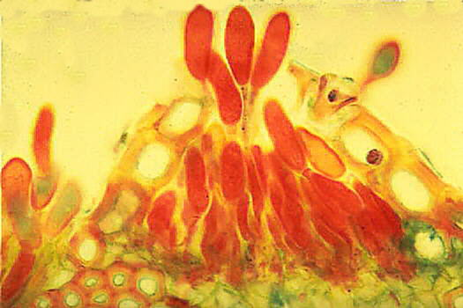
Puccinia Uredo-sporangium-Wheat
Notes:
‹#›

Slide 16
Uredospore are stalked, unicellular oval, binucleate structures, rusty red in colour.
Notes:
‹#›

Slide 17
Telial Stage:
Late in growing season, Uredospores are metamorphoses into Telutospores in the same Uredosori.
Uredosori is known as Telutosori.
Telutospores are dark brown or black in colour.
Notes:
‹#›

Slide 18
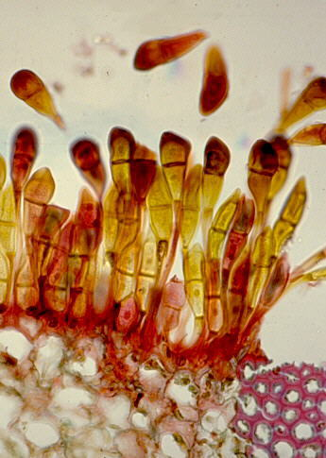
Stage III: Telia bearing teliospores (n+n>2n)
Notes:
‹#›

Slide 19
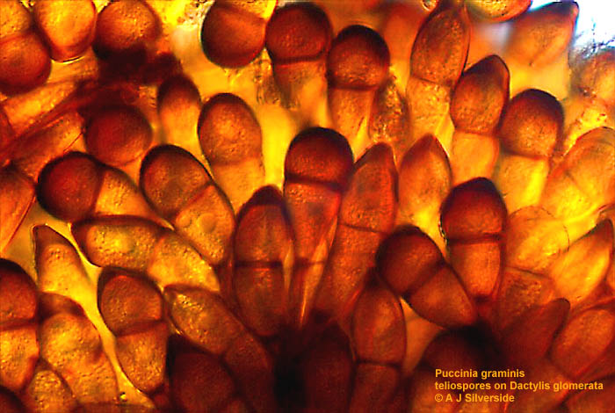
Puccinia Teluto sporangium
Telutospores
Notes:
‹#›

Slide 20
Telutospores Dark brown or black in colour. stalked, two celled, spindle shaped. The wall is thick, black and smooth.
Notes:
‹#›

Slide 21
Puccinia teluto spores
Each cell has two nuclei (one plus strain and the other of minus strain).
final stage on primary host
Telutospore matures, the nuclei in each cell fuse to form a diploid nucleus (Kayogamy) (2N).
Notes:
‹#›

Slide 22
Germination of Teluto spore
On Soil
Favourable condition- Proper Temperature, Moisture
Germination of Teluto spore- germination tube - Epibasidium
Notes:
‹#›

Slide 23
Germination of Teliospore
Germination tube
Notes:
‹#›

Slide 24
Germinated Teluto spore and formation of Basidium & Basidio spores
Basidio spore
(+) Or (-)
Sterigmata
Epibasidium
Basidium
Hypobasidium
Notes:
‹#›

Slide 25
Basidiospores (+ and -)
Basidiospores germinate on upper epidermis of Barberry leaf and produce Pycniosporangium
Notes:
‹#›

Slide 26
Stages of Puccinia on Barberry leaf
Pycniospores stage: On upper epidermis with +ve and – ve basidiospores (Sexual reproduction) (Plasmogamy)
Aecidiospore stage: On lower epidermis, Binucleate Aecidiospore
Notes:
‹#›

Slide 27
Infection of Puccinia on Barberry leaf Lower and Upper sides
Notes:
‹#›

Slide 28
Puccinia Pycnium on Upper epidermis
Notes:
‹#›

Slide 29
Receptive hyphae and Spermatia
Spermatia
Receptive hyphae
Notes:
‹#›

Slide 30
Develop-ment of Aecidiosporangium
Notes:
‹#›

Slide 31
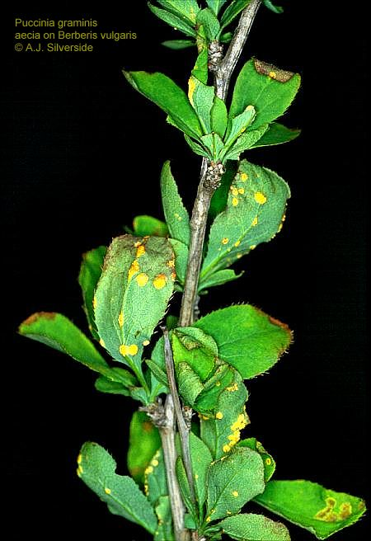
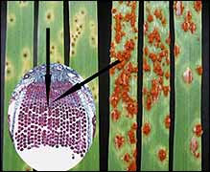
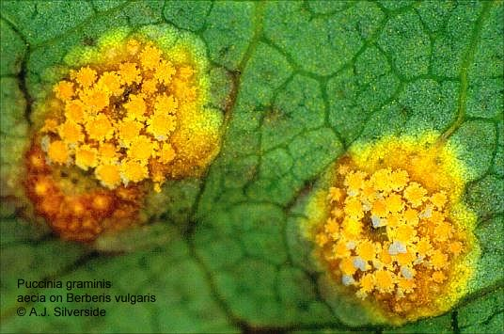
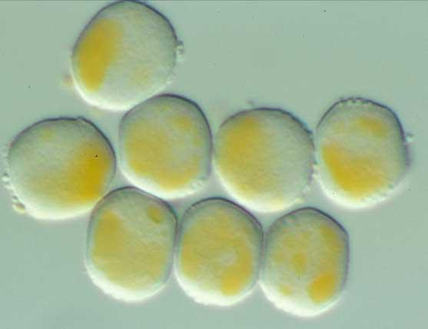
Stage I: Aecia bearing aeciospores (n+n)
Notes:
‹#›

Slide 32
Puccinia- Aecio sporangium on lower epidermis aeciospores infect primary host. Aeciospores produced on alternate host (e.g.,Barberry) infect primary host (e.g., grasses)
Notes:
‹#›

Slide 33
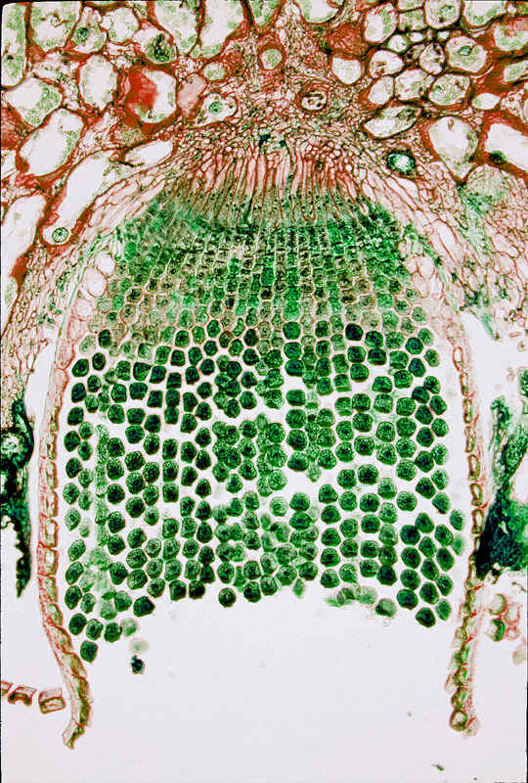
Aeciospores- round, yellowish red, Unicellular, binucleate, thick walled, 6 germ pores.
Germinate on wheat plant.
Aecidiosporangium
Aeciospores
Notes:
‹#›

Slide 34
Puccinia- Polymorphic fungi
Polymorphism: Various types of spores produced during life cycle according to hosts life cycle and climatic condition.
Known as Polymorphism.
Fungi shows polymorphism known as Polymorphic fungi.
Notes:
‹#›

Slide 35
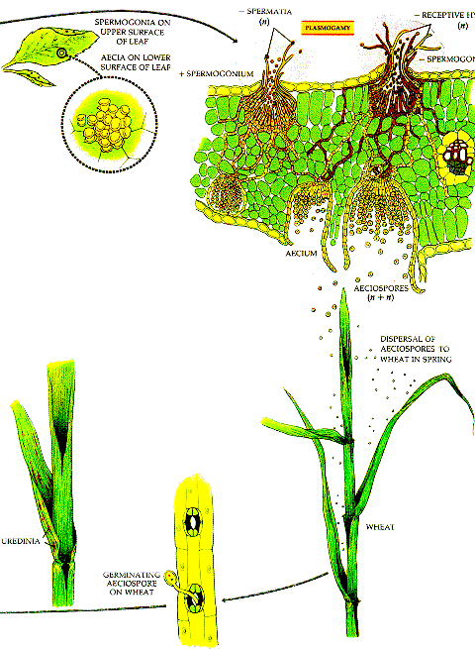
Puccinia Life Cycle
Notes:
‹#›

Slide 36
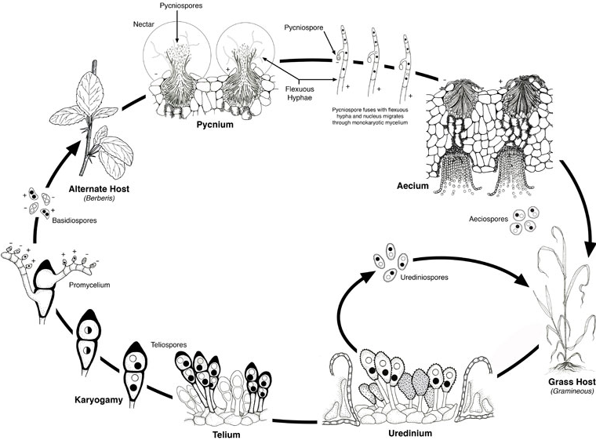
Puccinia life cycle
Puccinia Life Cycle
Notes:
‹#›

Slide 37
Thank You

